Slide 1


Project II(3360707)
Code Trainer
Prepared By:
Pratik B. Kansara(176620307029)
Pranav P. Chanpara(176620307016)
Vandit D. Joshi(176620307028)
Rutvik M. Kothariya(176620307031)
Diploma Computer Engineering
Darshan Institute of Engg. & Tech.
for Diploma Studies, Rajkot.
Guided By:
Prof. Payal M. Boda
Computer Engineering Dept.,
Darshan Institute of Engg. & Tech. for Diploma Studies, Rajkot

Slide 2
1. ABSTRACT
In present scenario usage of technology is widely increased mainly usage of internet had reached to every home. For eg. if you have to compile java program then we need JDK(Java Devlopment Kit) installed in your system. It is time taking process. But if you use our website no need to install JDK to your system. Our website allows you to compile source code and execute it online in different languages. Our website will provide online debugging and also allow to run the code in threee different languages. Users need to write code in editor and press "Run" button to compile and execute it. User also solve problem to increase logic by clicking problem solving.

Slide 3
2. PROBLEM SUMMARY
2.1 Problem Identification
If a user has to run and execute the source code of the program, he has to install all the necessary software in the system they will consume more required space in the device. And this is time taking process. Use can not do coding of different languages using one software.
2.2 Problem Solution
By using our website the space required to install software will be reduced on your device. And user can perform coding of different programming languages like c,c++ and java at the same place..

Slide 4
3. DETAIL DESCRIPTION
Admin :
The Admin can register and add task and its various input and output. Admin can also
See user that register to website.
a_ID: Id of Admin
admin_name: Name of admin
admin_pass: Password of admin
InputOutput :
Various input and output added by admin are stored here. It contain inputs and appropriate output.
io_ID: Id of io
input: For input
output: For output
t_ID: Id of task

Slide 5
Tasks :
The various tasks added by admin are store here.Admin can add , delete , update tasks as per needed.
t_ID: ID of task
t_name: Name of task
t_description: Description of task
t_noOfTestcase:How many testcase to be added
t_noOfInput: How many input in one testcase
t_noOfOutput: How many output in one testcase
ct_language: Language of task
Completed Tasks :
It stores task completed by user. If user satisfy testcase entered by admin then task is completed and stored. Admin can see Completed tasks done by user.
ID: Id of Completed tasks
u_ID: Id of user
t_ID: Id of task

Slide 6
Users
The all details of user are stored here like id,username,password,etc.Admin can see user last login , user is active as well as user name.Admin can delete user if needed.
u_ID: Id of user
user_name: Name of user
user_pass: Password of user
user_email: Email of user
user_last_login: User last login
user_joined: user Joined date
is_active: activation of user inform of (0) for deactivate and (1) for activate

Slide 7
4. DATA DICTIONARY
4.1 Database Tables
ct_user
Field name | Data type | Size | Constraint | Reference | Description
u_ID | int | 20 | Primary Key | - | To get user Id
user_name | varchar | 60 | NOT NULL | - | To get user name
user_pass | varchar | 255 | NOT NULL | - | To get user password
user_email | varchar | 100 | NOT NULL | - | To get user email
user_last_login | datetime | - | NOT NULL | - | Time to get user lastlogin
user_Joined | datetime | - | NOT NULL | - | User joined time
Is_active | boolean | - | NOT NULL | - | For user activation check

Slide 8
ct_admin
Field Name | Data type | Size | Constraint | Reference | Description
a_ID | int | 20 | Primary key | - | For admin id
admin_name | varchar | 100 | NOT NULL | - | For admin name
Admin_pass | varchar | 100 | NOT NULL | - | For admin password
ct_tasks
Field Name | Data Type | Size | Constraint | Reference | Description
t_ID | int | 20 | Primary Key | - | Tssk Id
t_name | Varchar | 100 | NOT NULL | - | Taskname
t_description | Varchar | 100 | NOT NULL | - | Task description

Slide 9
ct_io
Field Name | Data type | Size | Constraint | Reference | Description
io_ID | int | 20 | Primary Key | - | Contain comment ID
input | Varchar | 500 | NOT NULL |  | For input
output | Varchar | 500 | NOT NULL | - | For output
t_ID | int | 50 | NOT NULL | - | For taskId
ct_completedtasks
Field Name | Data Type | Size | Constraint | Reference | Description
ID | int | 20 | Primary Key | - | For completed task id
u_ID | int | 20 | NOT NULL | - | For user id
t_ID | int | 20 | NOT NULL | - | For task id

Slide 10
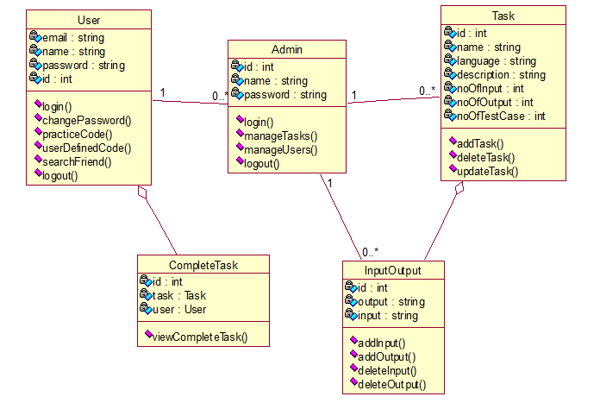
5. DIAGRAMS
5.1 Class Diagram

Slide 11
5.2 Sequence Diagram

Slide 12
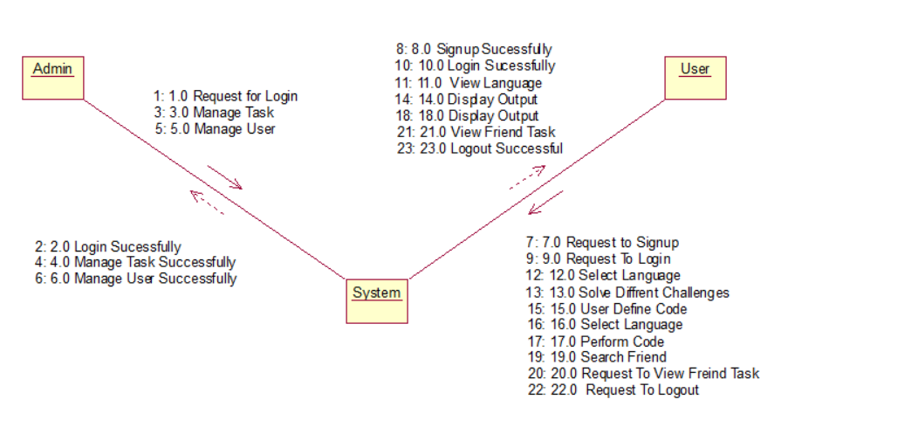
5.3 Collaboration Diagram

Slide 13
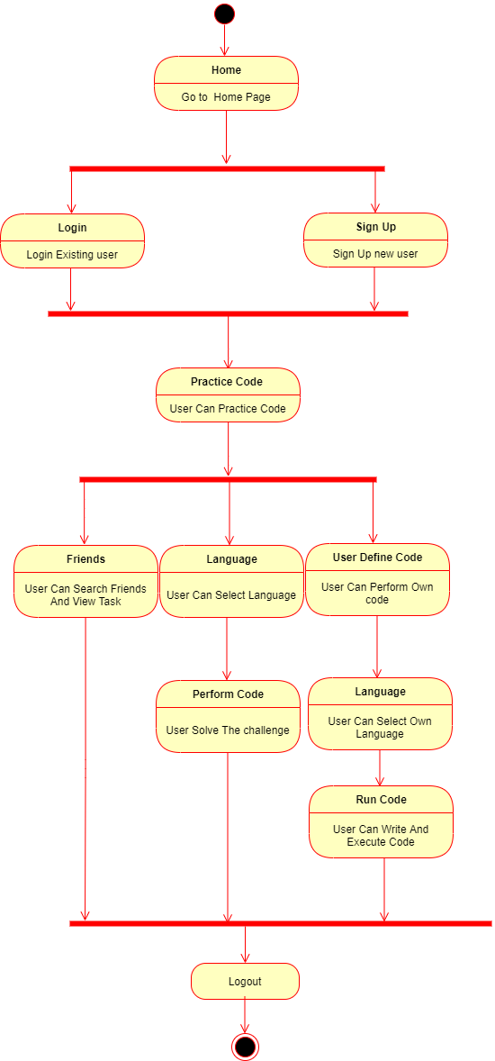
5.4 State Diagram

Slide 14
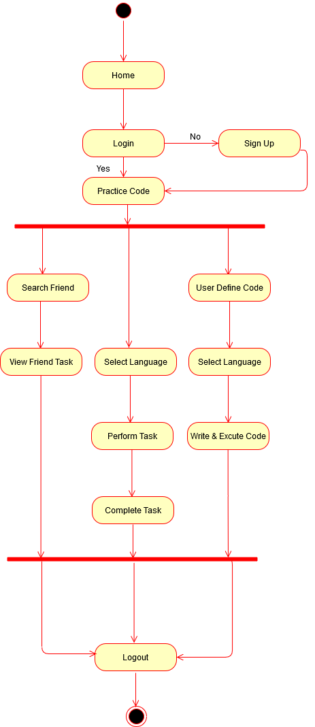
5.5 Activity Diagram

Slide 15
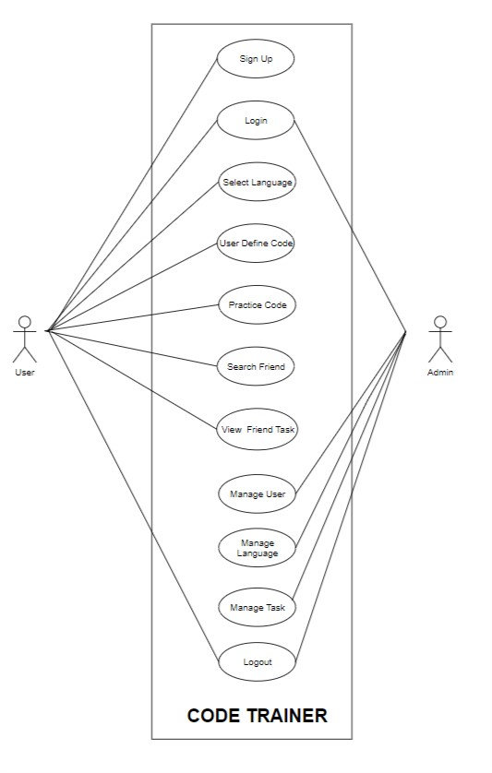
5.6 Use Case Diagram

Slide 16
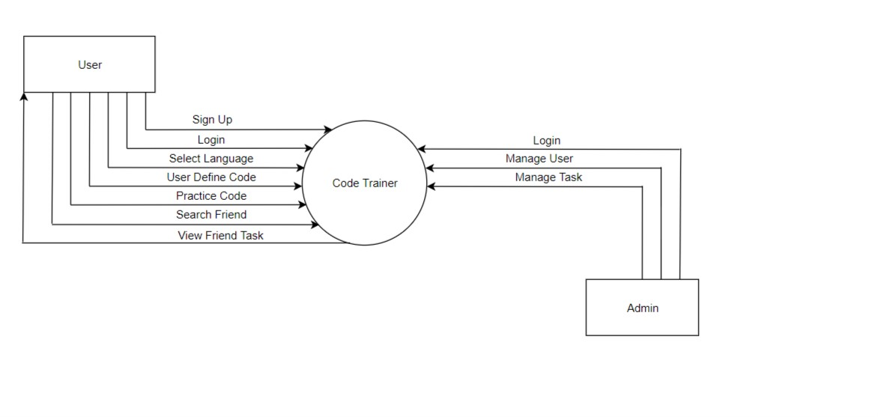
5.7.1 Data Flow Diagram

Slide 17
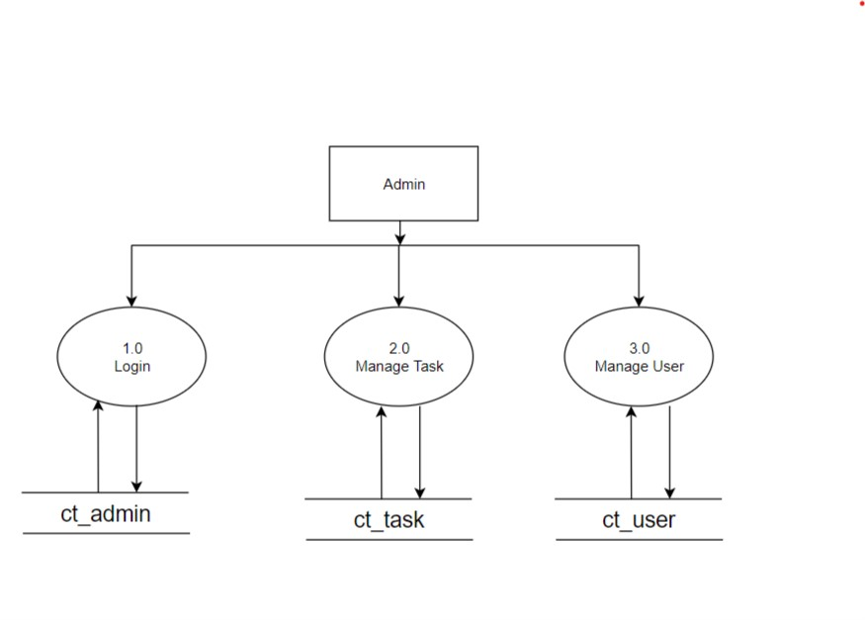
5.7.2 Data Flow Diagram - Admin(Level 1)

Slide 18
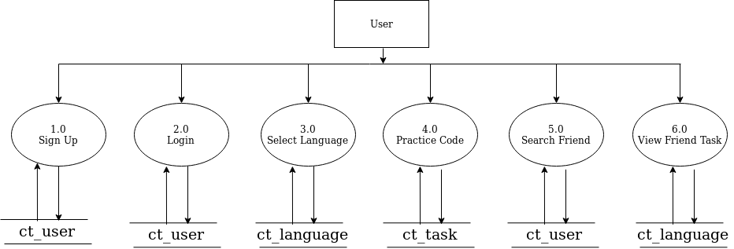
5.7.3 Data Flow Diagram for User(Level 1)

Slide 19
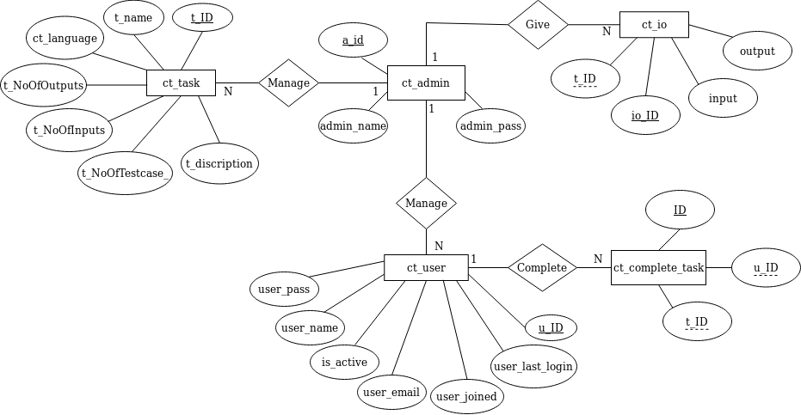
5.8 ER Diagram

Slide 20
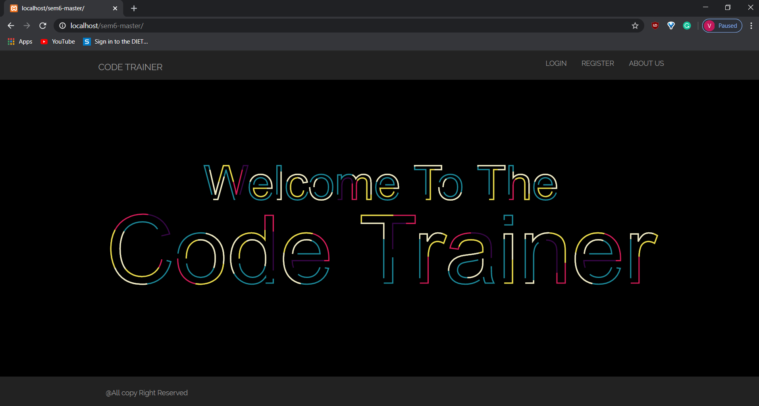
6. SCREENSHOTS
6.1 Welcome Page
It is an welcome page of website.
It appears before the starting of website.

Slide 21
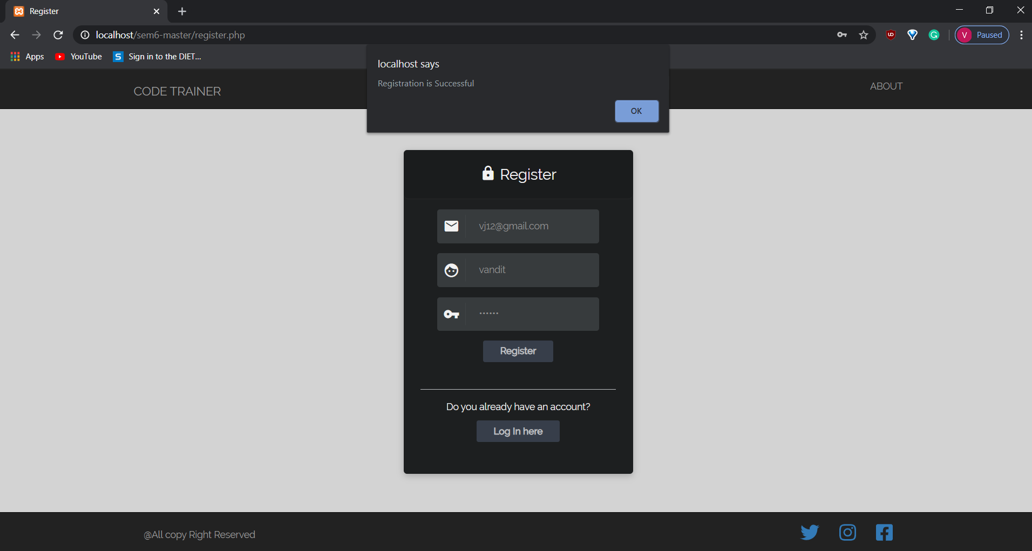
6.2 Register Page
This page displays the register process.
New users have to register their details in this page.
User can register by filling above details.

Slide 22
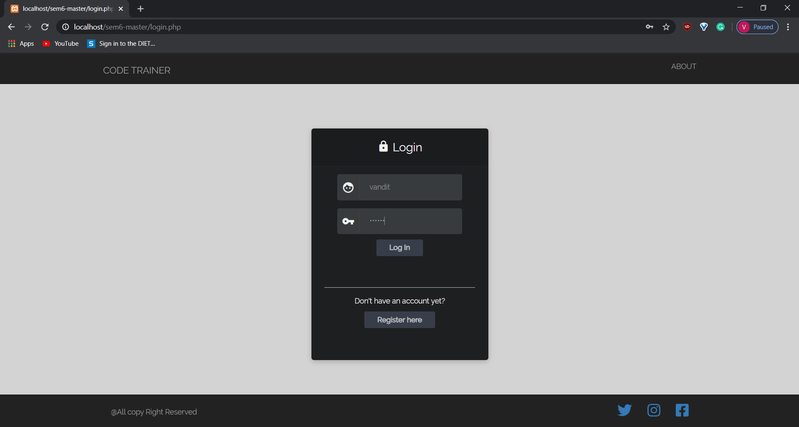
6.3 Login Page
This page displays the login process.
User has to login their account in this page for performing further operation.

Slide 23
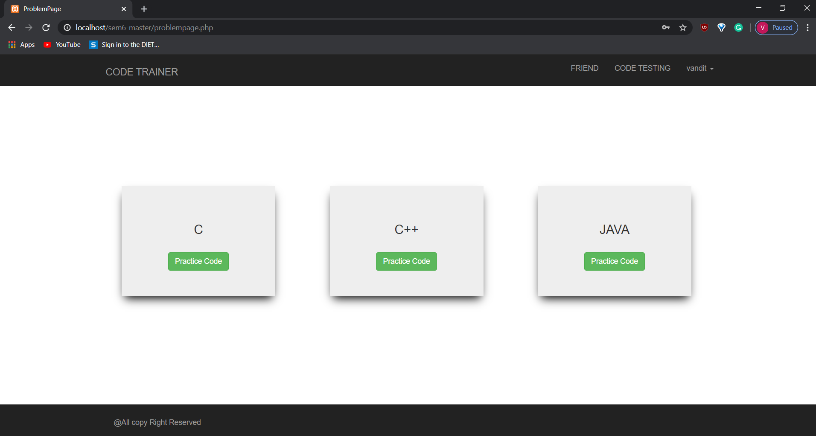
6.4 Home Page
This page displays the three different programming languages.
User has to select any one for performing further programming tasks.

Slide 24
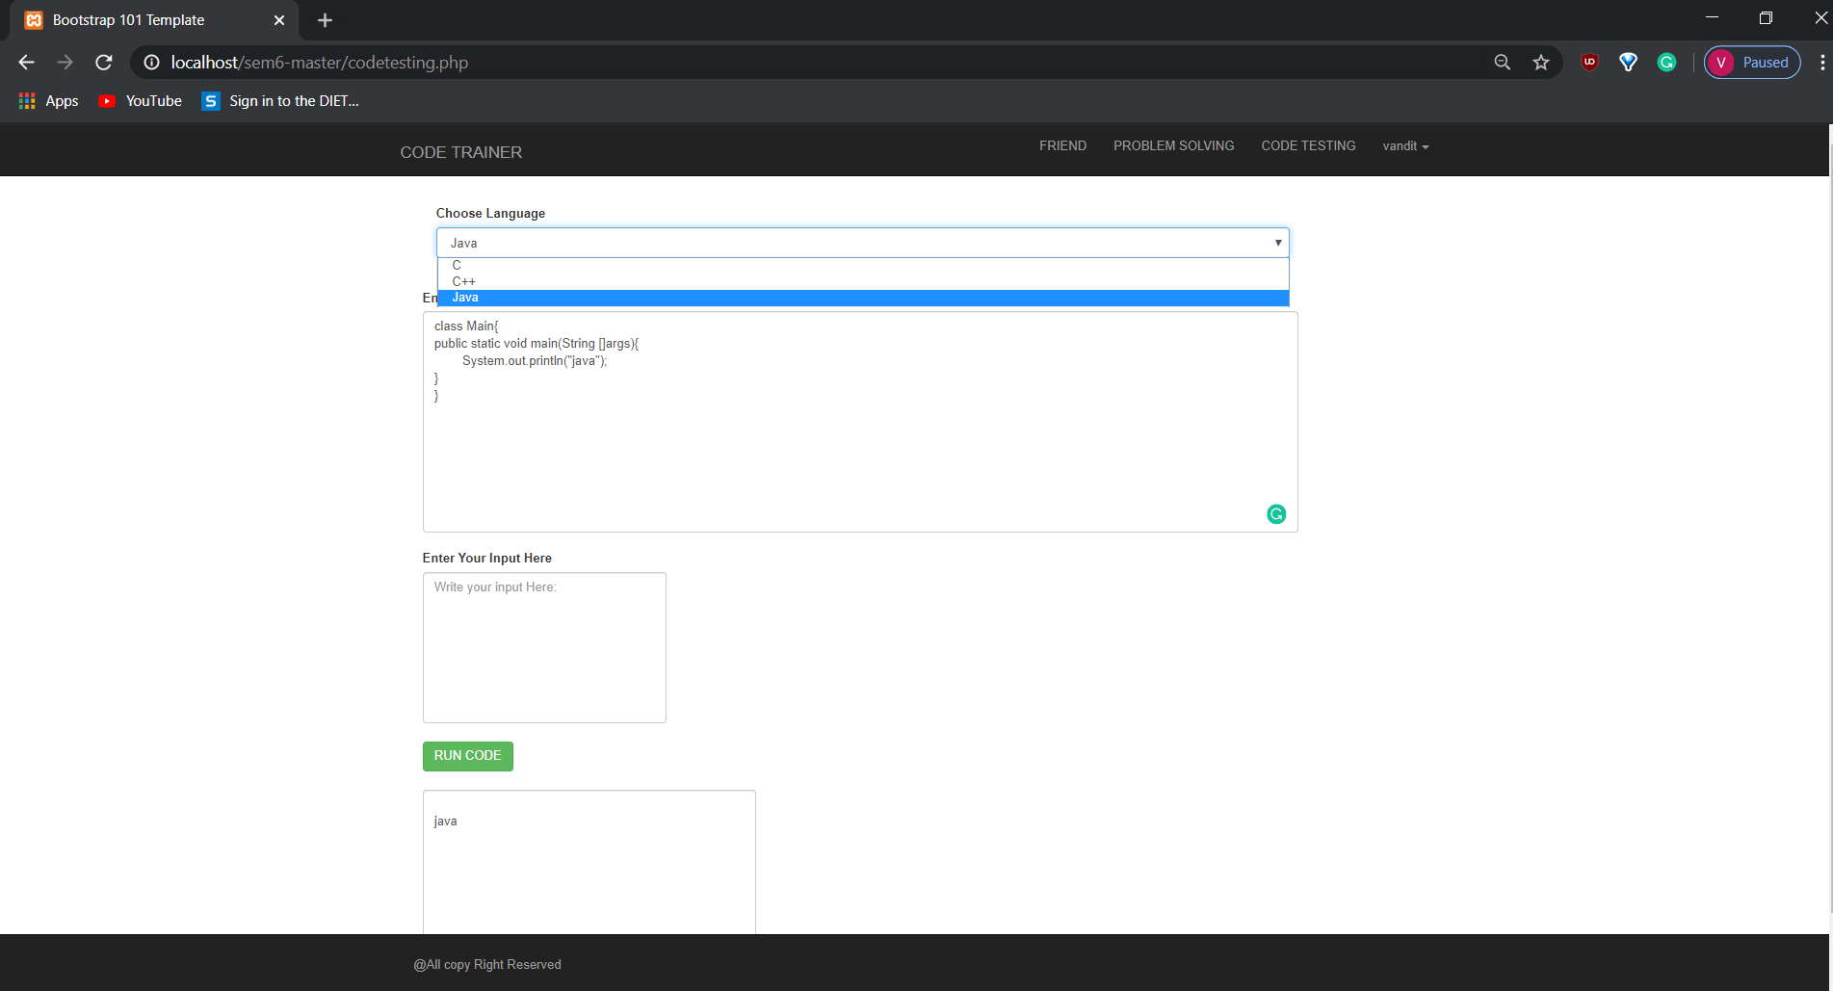
6.5 Code Testing Page
In this page user has to write code by selecting any one programming language from given options.
After the code is performed user has to run it by clicking on given green button.
The output of program will be displayed after clicking on green run code button.

Slide 25
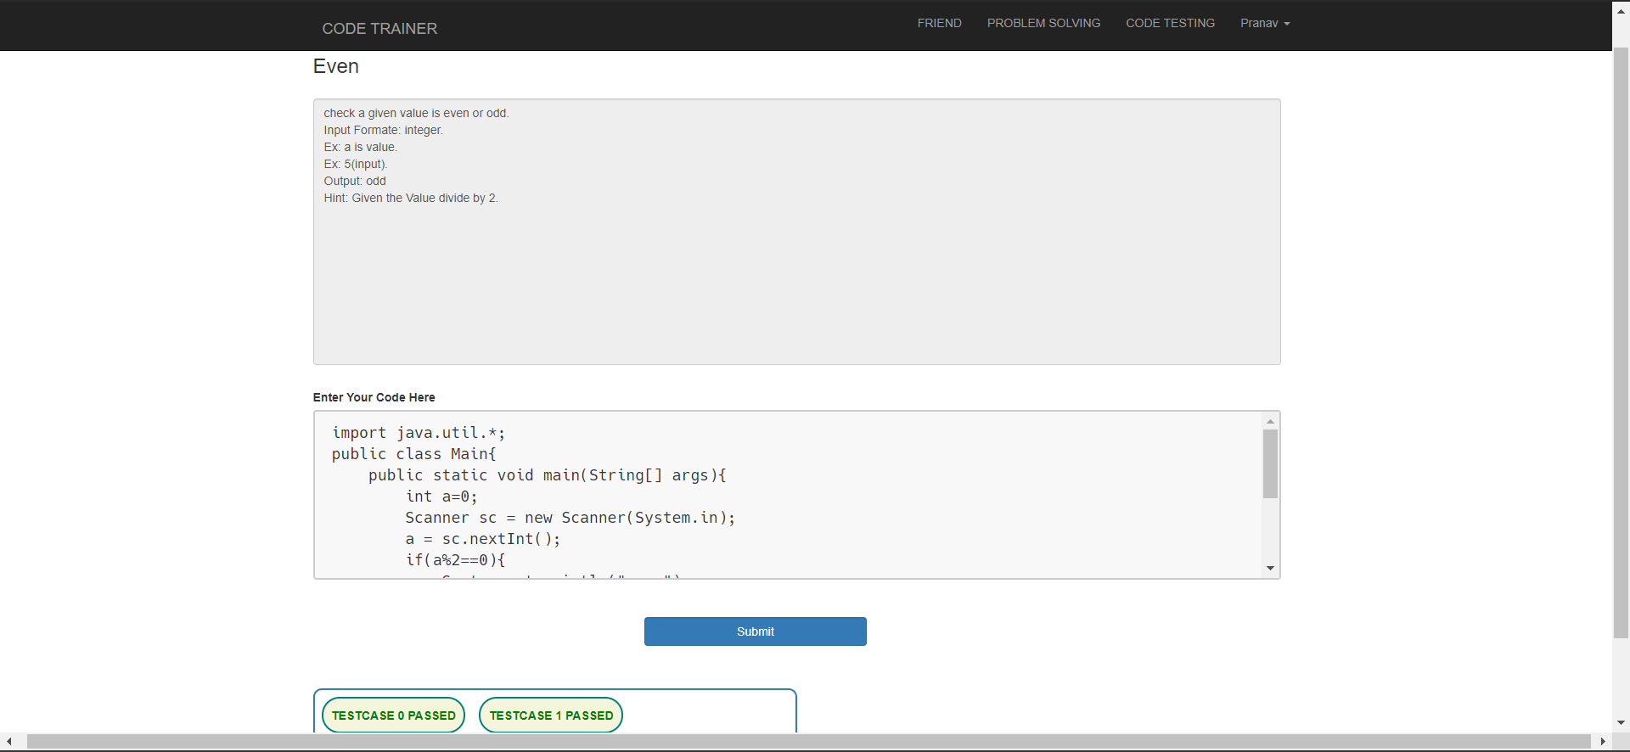
6.6 Problem Solving Page
Problem solving page displays about solving the errors in program performed.
User can improve their logic level in this page.

Slide 26
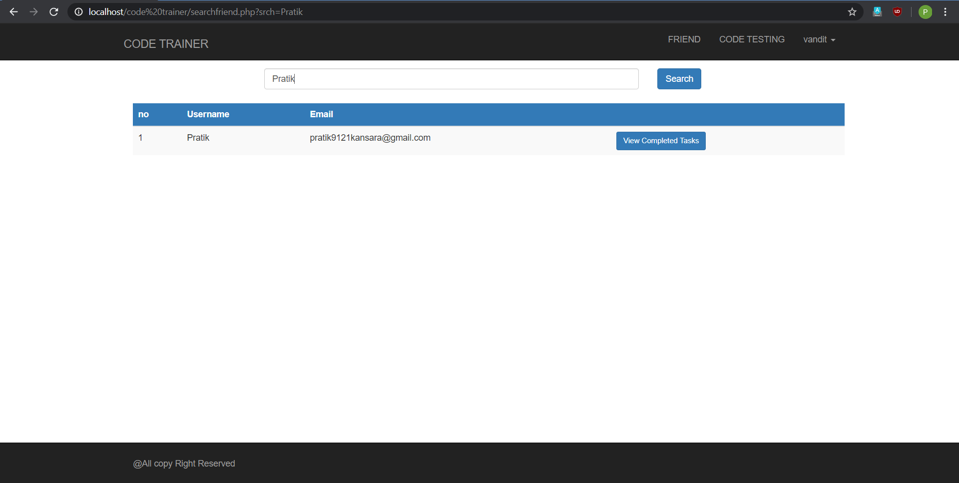
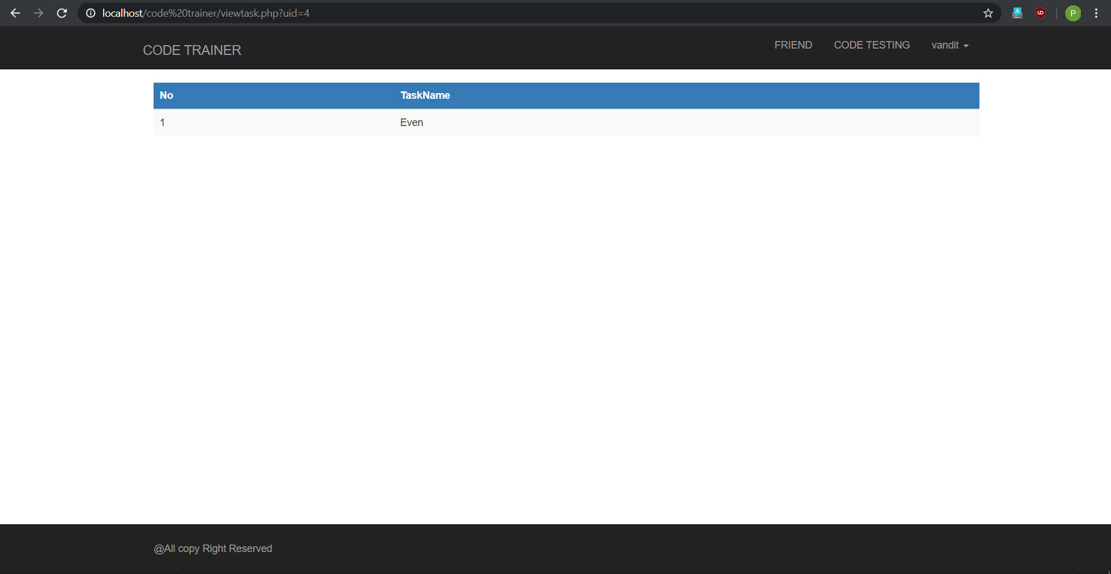
6.7 Search Friend
Fig 1.1 Fig 1.2
This is admin page for products.
Admin can manage products from here.
Admin can add, update and delete products from this page.

Slide 27
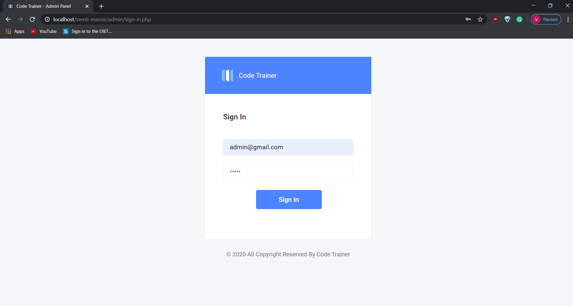
6.9 Sign Up Page for Admin
In this page admin has to fill all the details given.
Admin account will be created.

Slide 28
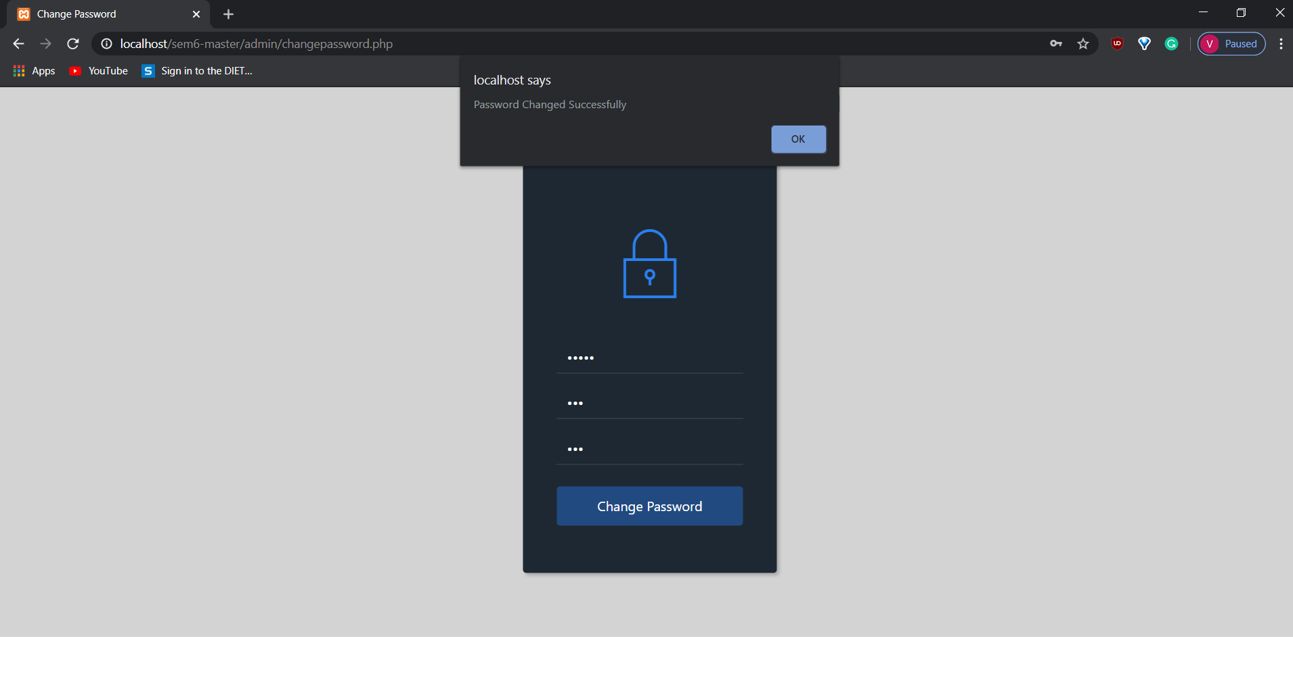
6.10 Change Password for Client
User can make changes in password in this page.
It appears when user forgets its own password.

Slide 29
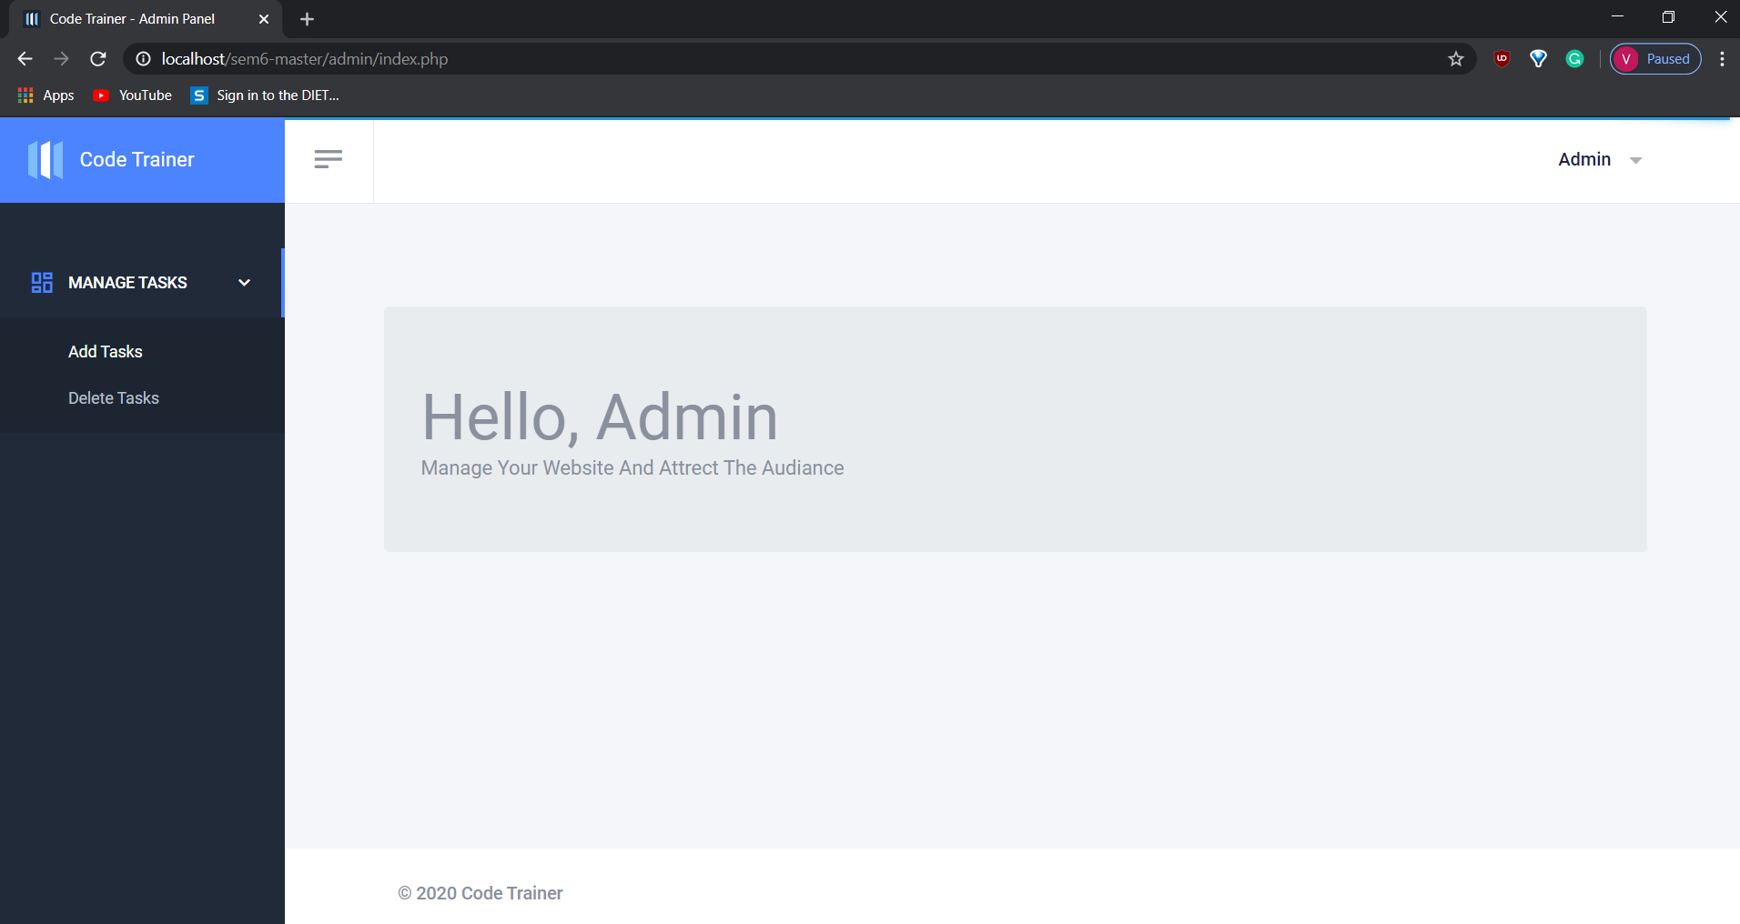
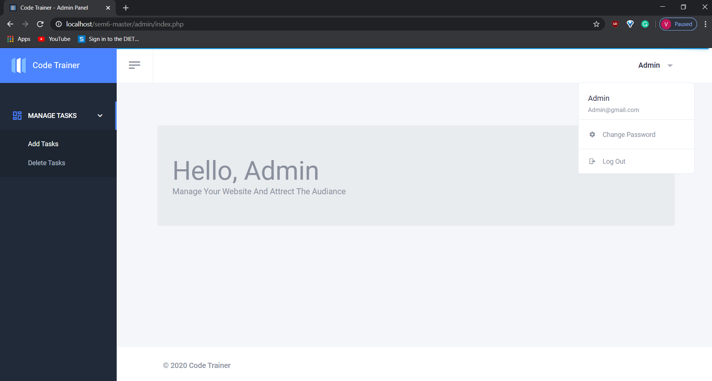
6.11 Admin Page
Fig 1.1 Fig 1.2
This is admin page.
Admin can manage tasks from here.
Admin can add, update and delete tasks from this page.

Slide 30
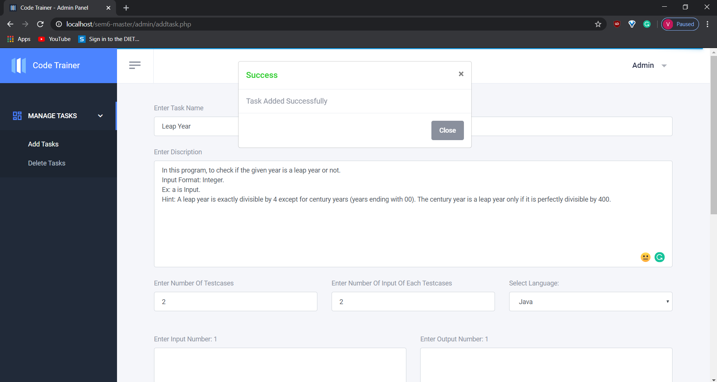
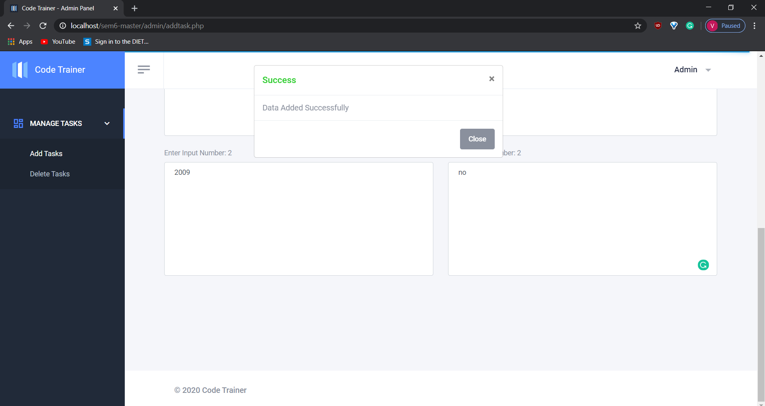
6.12 Manage Task Page
Fig 1.1 Fig 1.2
Fig 1.1 displays about adding tasks.
Fig 1.2 displays about adding the data of task given.

Slide 31
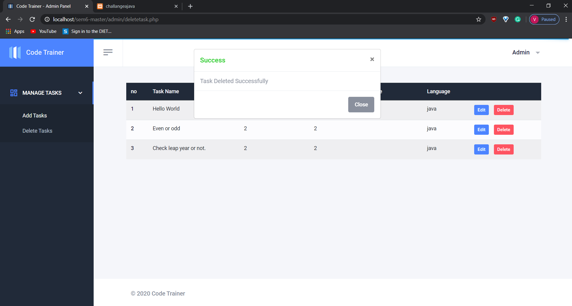
Fig 1.3
Fig 1.3 displays about deleting tasks.

Slide 32
6.13 Password Change Page for Admin
This page specifies to change the password in any condition.
If user forgets or has to create new password then this page is loaded.

Slide 33
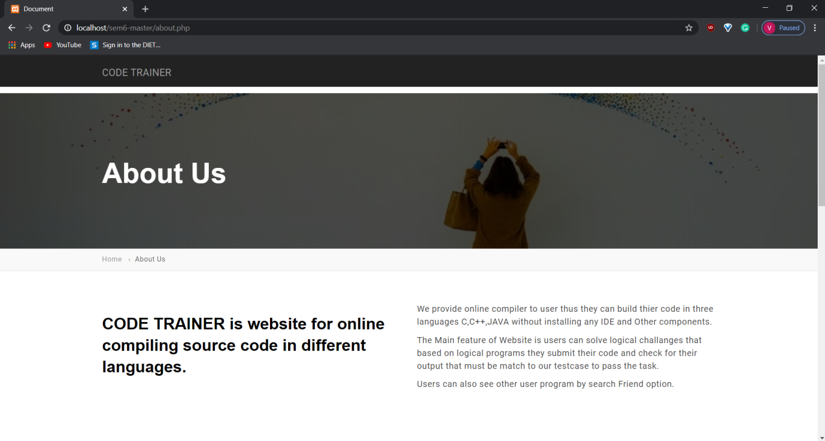
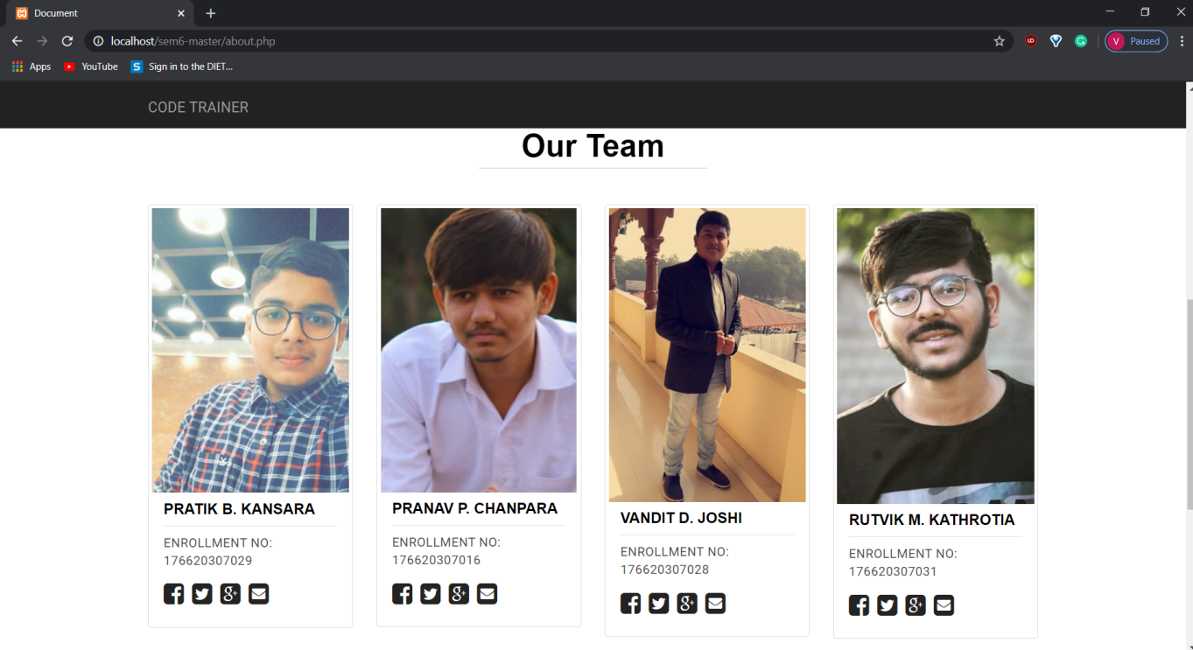
6.14 Contact page
Fig 1.1 Fig 1.2
Fig 1.1 displays the information about this website.
Fig 1.2 displays the information about the creators of this website.

Slide 34
7. CONCLUSION
By this website user can perform their code on one platform and time will be saved. User can also practice their code in our website and no need to install unnecessary languages in device so it will not require space.

Slide 35
Thank You & Any Questions?

